Slide 1
Mining Cultural Differences of Named Entities from Large Text
2016-09-28

Slide 2
Outline
1.Introduction
2.Approach
3.Evaluation
4.Conclusion
5.Q&A

Slide 3
Introduction
Named Entity: a named entity is a real world object such as persons, locations, organizations, products, etc. , which can be denoted with a proper name. (from Wikipedia)
Opinions of named entities may differ from culture to culture.
Two types of cultural differences:
1.People see it from different angles.
2.Some people just know its basic info.

Slide 4

Type1:
“克什米尔” on Chinese Bing Image Site
“Kashmir” on Global Bing Image Site

Slide 5
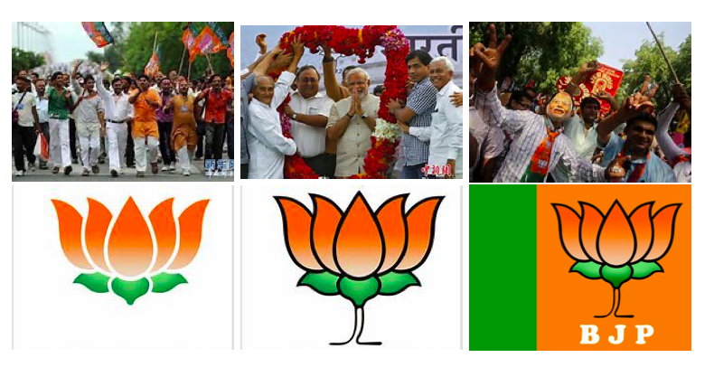
Type2:
“印度人民党” on Chinese Bing Image Site
“Bharatiya Janata Party” on Global Bing Image Site

Slide 6
Introduction
1.Applications:
Instant messenger
Machine translation
Culture studies
2.Challenge:
a. it’s very subtle
b. perfect understanding of two languages
c. large volumes of bilingual reading
3.Transform this problem into a computational task

Slide 7
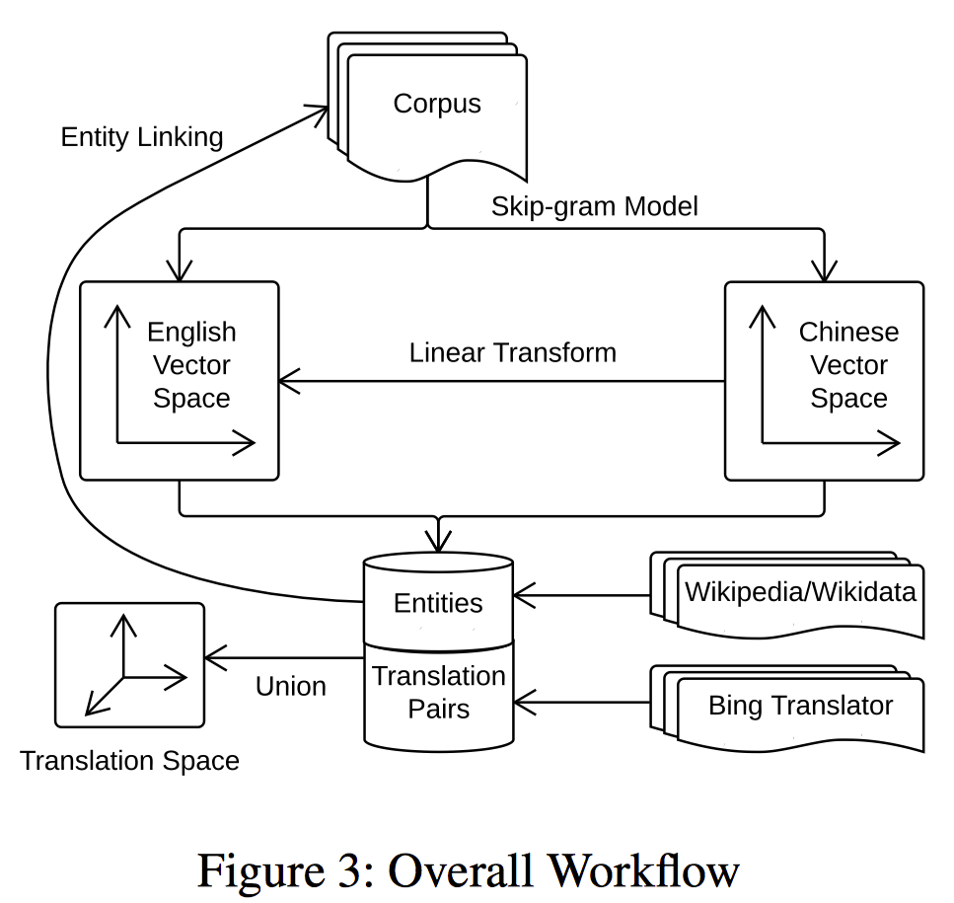
Approach
Vocabulary Building
Entity Linking
Word Embedding
Cultural Similarity Computation
Linear-Transform Algorithm
Translation Space Algorithm

Slide 8
Entity Linking
Clinton delivered a speech yesterday.
or
Bill Clinton
Hillary Clinton
We thus achieve accuracies of 96.7% and 94.7%, respectively.

Slide 9
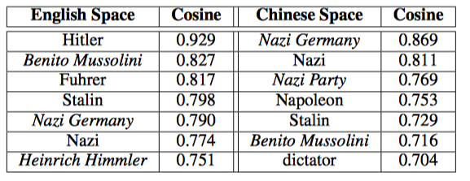
Word Embedding
Goal: Build a vector space to represent the semantic meaning of a word.
word2vec: Skip-gram Model , 150 dimensions
Adolf Hitler

Slide 10
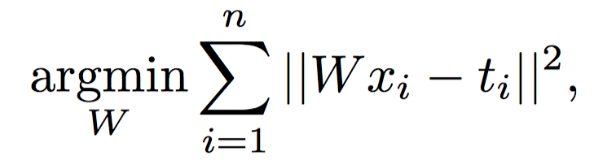
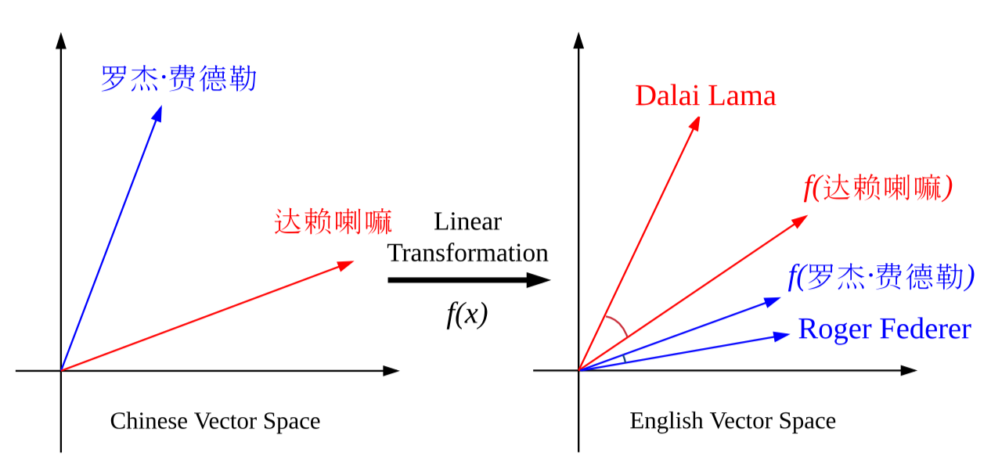
Linear-Transform Algorithm
x_{i} is vector of a Chinese word
t_{i} is vector of its translation
n is the size of training samples : 100
=Wx_{i}

Slide 11
Quiz: size of W
150 * 150

Slide 12
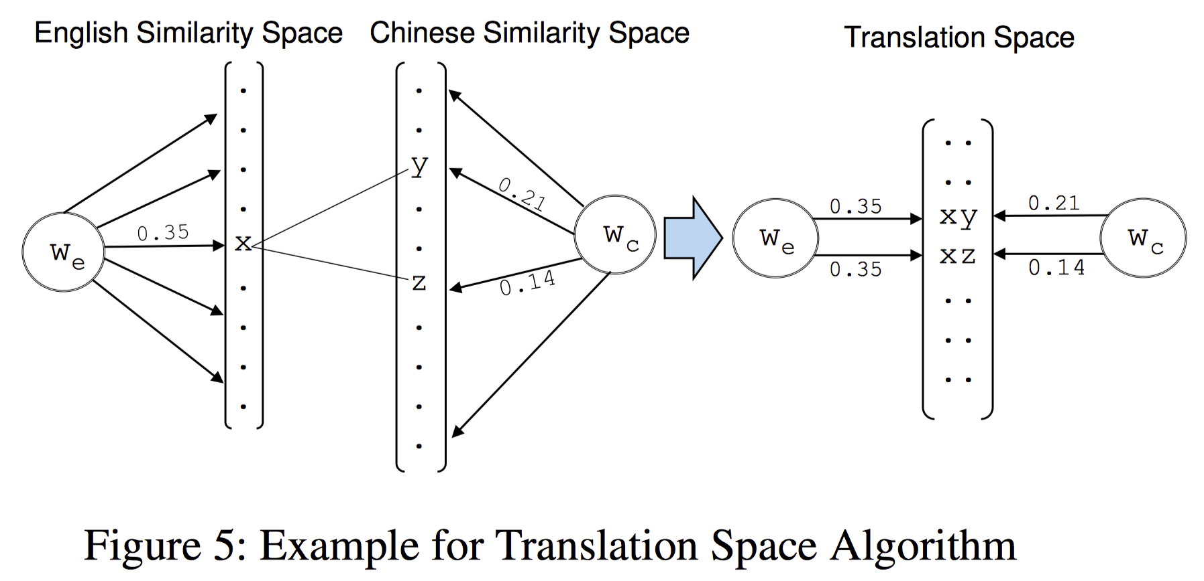
Translation Space Algorithm
文学
literature
Columbia University
文献
哥伦比亚大学
xy: <literature,文学>
xz: <literature,文献>
Len= 122,284
Len=45,740
Len= 47,854

Slide 13
Evaluation
1. Data preparation
English: Daily Mail & New York Times (1,857,581 in total)
Chinses: 凤凰新闻、中国新闻网 (673,655 in total)
Entities: Wikipedia & Wikidata
Translation Pairs: Bing Translation (122,284)
2. Ground Truth
14 Annotators
885 named entities which are from top 2000 both in English and Chinese
20/20 pics
We choose 497 entities that are well-annotated.

Slide 14
Evaluation
3. Baseline
1. Random Classifier
2. Ranking by Popularity (relative frequency )
4. Experiment

Slide 15
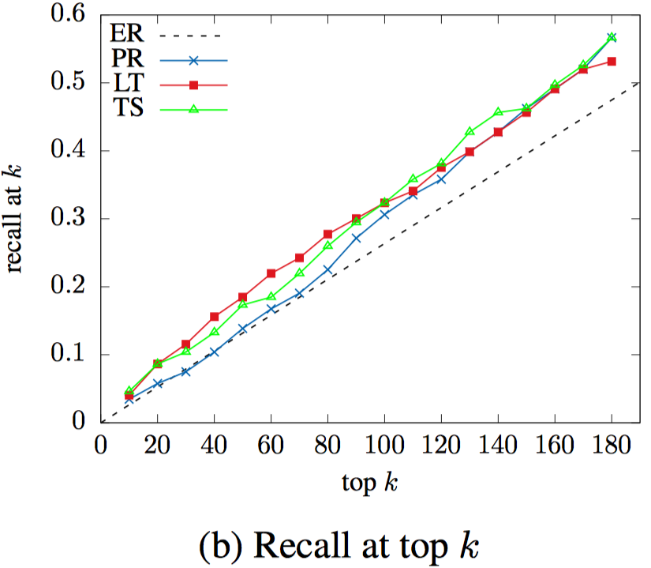
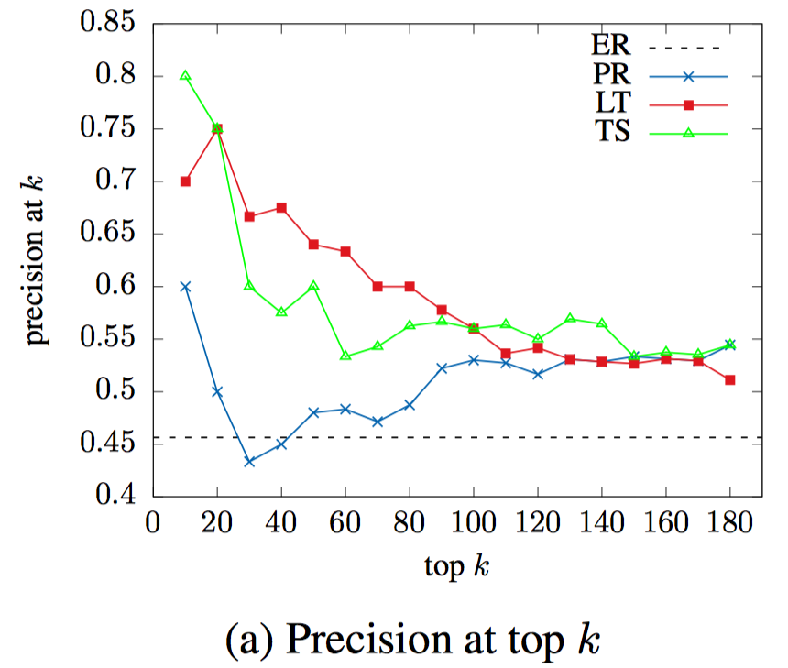
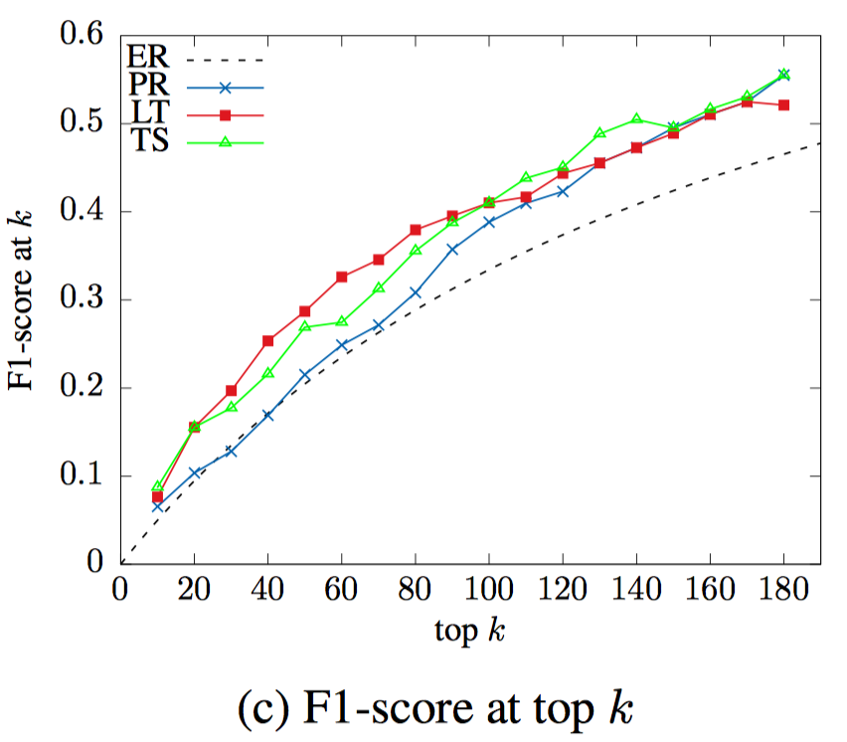
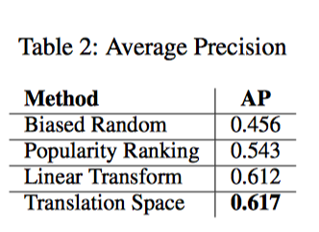
Experiment

Slide 16
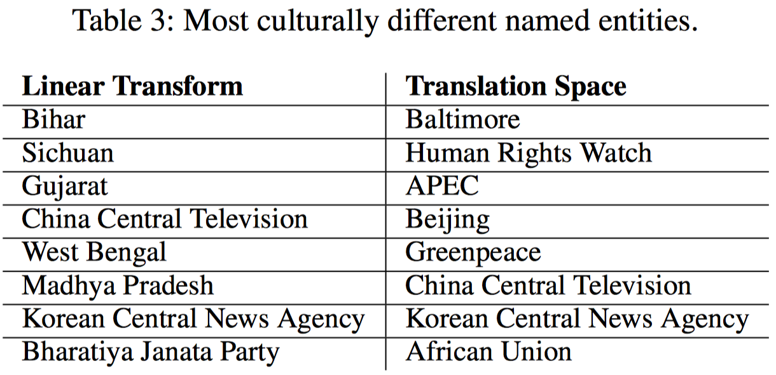

Slide 17
Conclusion
1.Contribution
We are the 1st to study the problem of mining cultural differences of named entities and to present a data-driven approach to solve it;
We computed the cultural difference scores for 4,212 named entities.
Evaluation shows that the computed scores correlated well with human perception of cultural differences
2.Future work
Improve recall of entity linking
Other corpus
Apply confidence into Translation Space
Other way to get ground truth

Slide 18
Q&A
Thank You For Listening !

